Slide 1
Dynamic Internet Technologies
PHP – server side sanitisation of data

Slide 2
Content
Some server-side sanitisation of data
Reducing the chances of input validation attacks by sanitising data
  Using sanitise filters to remove tags and illegal characters
  Using prepared statements for database queries, e.g. for logon
Other examples of prepared statements
  Search queries
  Inserting a new record

Slide 3
Re-cap: input validation attacks
Send data the application does not expect
Intentions include:
  Data disclosure or modification
  System compromise
  Denial of Service (DoS)
  Arbitrary command execution
  Can target any modifiable data sent to the server
So validate ALL input data
  First validate that the input data exists
  Then make sure that it is safe

Slide 4
Sanitising input (cleaning it) to avoid problems
Certain data input can cause problems, e.g.
Special characters like &, ' etc. -
  Database insertion issues
  Allowing SQL injection attacks
Tags (like html) -
  Cross-site scripting (XSS) attacks
  Garbled web pages
To reduce the chances of problems we can make strings safe by sanitising data
Examples
  Stripping HTML (including <script>) and PHP tags from input strings
  Converting special characters
  Using prepared statements to make strings safe for use in SQL statements

Slide 5
Sanitising and validating data using filter-var
filter_var() - filters variables
It can be used to sanitise or validate
  Sanitisation with filter_var - removes non-allowed content
  Validation with filter_var – checks data is in a proper form

Slide 6
Some possible filters for sanitising data
FILTER_SANITIZE_EMAIL | Remove all characters except letters, digits and !#$%&'*+-/=?^_`{|}~@.[]
FILTER_SANITIZE_NUMBER_FLOAT | Remove all characters except digits, +- and optionally .,eE
FILTER_SANITIZE_SPECIAL_CHARS | HTML-escape ' " < > & and characters with ASCII value less than 32
FILTER_SANITIZE_STRING | Strip tags, optionally strips or encodes special characters
FILTER_SANITIZE_URL | Remove all characters except letters, digits and $-_.+!*'(),{}|\\^~[]`<>#%";/?:@&=
Source: PHP: Sanitize filters - Manual

Slide 7
Both sanitising and validating using filter_var
We may wish to sanitise data to remove non-appropriate characters (for example, to aid the user) before validating it. Examples could include:
$emailAddress = filter_var($emailAddress, FILTER_SANITIZE_EMAIL);
if (!filter_var($emailAddress, FILTER_VALIDATE_EMAIL)) {
echo "<p>$emailAddress is not a valid email address</p>\n";
}
$webAddress = filter_var($webAddress, FILTER_SANITIZE_URL);
if (!filter_var($webAddress, FILTER_VALIDATE_URL)) {
echo "<p>$webAddress is a not a valid URL</p>\n";
}

Slide 8
Sanitising input by removing tags 1
Example 1: preventing a cross-site scripting (XSS) attack
Attacker inserts code like the following as input to, e.g., a message board:
Hello!
<script type="text/javascript">
  var adr = '../evil.php?cakemonster=' + escape(document.cookie);
  </script>
What happens when another user views the message post?
The contents of that user’s cookie will be sent to evil.php
With filter_var and the FILTER_SANITIZE_STRING filter, e.g.
$message = filter_var($message, FILTER_SANITIZE_STRING, FILTER_FLAG_NO_ENCODE_QUOTES);
The value of $message would be sanitised to:
Hello! var adr = \'../evil.php?cakemonster=\' + escape(document.cookie);

Slide 9
Improving the output – stripping slashes
The output in the browser for the previous example contained backslashes to escape the single quotes, e.g.
Hello! var adr = \'../evil.php?cakemonster=\' + escape(document.cookie);
These were automatically added by our server
Quotes will be automatically escaped if the PHP directive magic_quotes_gpc is enabled
To improve the output - test if magic_quotes_gpc is on, and if so, use stripslashes() to strip backslashes before outputting content to the browser
Example
if (get_magic_quotes_gpc()) {
$message = stripslashes($message);
}
IMPORTANT – DON’T do this before inserting data into a place (such as a database) that requires escaping

Slide 10
Sanitising input by stripping tags 2
Example 2: preventing garbled web pages
A user enters the following input for a product description form field -
<p>Great & > "superb"</p>
(Example without sanitisation)
With filter_var and the FILTER_SANITIZE_STRING filter, e.g.
$desc = filter_var($desc, FILTER_SANITIZE_STRING, FILTER_FLAG_NO_ENCODE_QUOTES);
The tags would removed so that the value of $desc would become (without stripslashes()):
Great & > \"superb\"
(Example with sanitisation)

Slide 11
Sanitising special characters in input
Use the FILTER_SANITIZE_SPECIAL_CHARS filter to HTML-escape
' " < > & and characters with ASCII value less than 32 encoding them and
making them safe
Example: a user enters the following input –
<p>Great & > "superb"</p>
With sanitisation, e.g.,
$desc = filter_var($desc, FILTER_SANITIZE_STRING, FILTER_FLAG_NO_ENCODE_QUOTES);
$desc = filter_var($desc, FILTER_SANITIZE_SPECIAL_CHARS);
The input will be sanitised to become (without stripslashes()):
  Great &#38; &#62; \&#34;superb\&#34;

Slide 12

Logon system example (again)
Prevents data being visible in
the URL
<form id="logonForm" method="post"
action = "logon.php">
Name:
<input type= "text" name="userName" />
Password:
<input type="password" name="pwd" />
<input type="submit" value="Login" />
</form>
This time we will look at how to sanitise data input
Masks
input

Slide 13
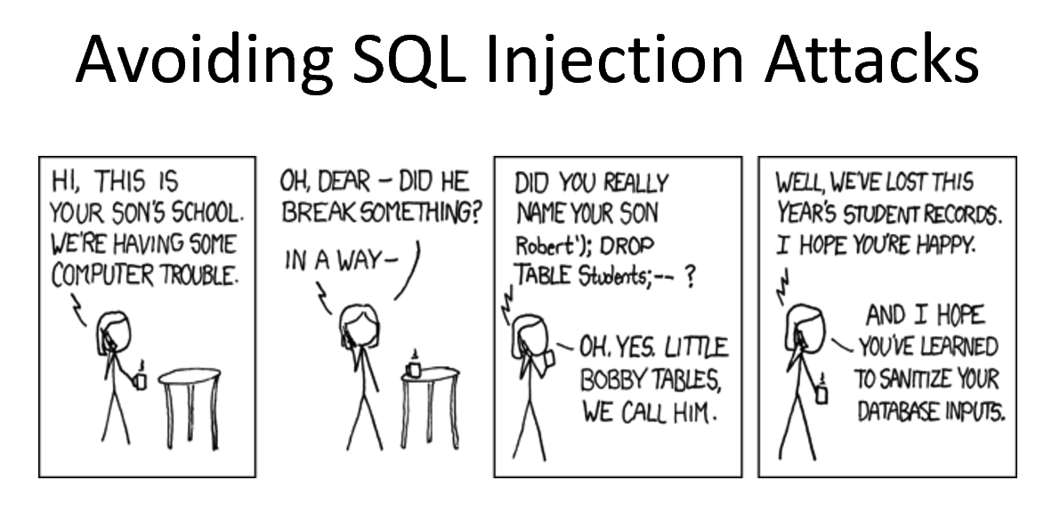
SQL injection attacks
We need to sanitise data input

Slide 14
Example SQL injection attack on a login system
Sample input
username: izge1234 password: ' OR ' '='
If we used the following code to check that the log in details are correct
$sql = "SELECT * FROM customer WHERE username = '$username'
AND passwd = '$passWD'";
what would the value of $sql be?
SELECT * FROM customer WHERE username = 'izge1234' AND passwd = ' ' OR ' '=' '
What would be the problem?
You will be able to log in without a valid password! Anyone could do this.

Slide 15
Sanitising data input to prevent SQL injection attacks
  We can do this using prepared statements that make strings safe for use in SQL statements
  How it works – the main steps
    SQL statement with placeholders is set-up
    SQL statement is compiled (“prepared”)
    Bind values to the placeholders (one for each placeholder) using the values of variables (e.g., from form input)
    Then separately execute the prepared statement (with the bound values whose content is just data and has nothing to do with SQL statement parsing)

Slide 16
Prepared statement example – query for logon
$sql = "SELECT * FROM customer WHERE username=? AND passwd=?";
$stmt = mysqli_prepare($conn, $sql);
mysqli_stmt_bind_param($stmt, "ss", $uName, $passWD);
mysqli_stmt_execute($stmt);
Step 1: set-up the required sql and use placeholders (?s) to indicate where values for the fields in the WHERE clause will be bound
Step 2: Prepare (“compile”) the SQL statement
Step 3: Bind values to the placeholders (one for each placeholder) using the values of variables (from form input). For each placeholder we specify the type of data (here "ss" as both are strings)
Placeholder data
types include:
i = integer
d = double
s = string
b = blob
Step 4: Execute the prepared statement

Slide 17
Prepared statement example – query for logon
mysqli_stmt_bind_result($stmt, $uNameFromDB, $pwdFromDB);
if (mysqli_stmt_fetch($stmt) {
/* Now we could add code here to check whether the password entered in the logon form is the same as that stored in the database (here $pwdFromDB)*/
};
Step 5: Bind the query results to variables - one for each db field retrieved by the query (i.e. here they are username and passwd)
Step 6: If a record was found (i.e. the username entered by the user exists), fetch results from the prepared statement into the bound variables

Slide 18
Prepared statement example – for a search query
…
// Code to get the value for $category from the form input would be here
$sql = "SELECT itemCode, description, category, price FROM products WHERE
category = ?";
$stmt = mysqli_prepare($conn, $sql);
mysqli_stmt_bind_param($stmt, "s", $category);
mysqli_stmt_execute($stmt);
mysqli_stmt_bind_result($stmt, $prodID, $desc, $cat, $price);
while (mysqli_stmt_fetch($stmt)) {
echo "<div>$prodID, $desc, $cat, $price</div>\n";
}
mysqli_stmt_close($stmt);
mysqli_close($conn);
...
Set-up the sql and placeholder for the category db field
Bind value to the single placeholder – with data type "s" as category is a string in the db
Bind the query results to variables - one for each retrieved db field
Iterate through the query results. Inside the while loop we access the values for each record using the variables that we bound

Slide 19
Prepared statement example – inserting a new record
…
// Code to get values for $UID, $PID, $pRating from the form input would be here
// Then we would do the database part …
  include 'database_conn.php';
$sql = "INSERT INTO feedback (userID, productID, rating) VALUES (?, ?, ?)";
$stmt = mysqli_prepare($conn, $sql);
mysqli_stmt_bind_param($stmt, "ssd", $UID, $PID, $pRating);
mysqli_stmt_execute($stmt);
mysqli_stmt_close($stmt);
mysqli_close($conn);
…
Question: why would it be "ssd"
for the bound
parameters?
Note that we would similar php code, but with different SQL, to update or delete a record from a database using prepared statements.

Slide 20
References
PHP: Filter Functions - Manual. Available at: http://uk3.php.net/manual/en/ref.filter.php
PHP 5 Filter Functions. Available at: http://www.w3schools.com/php/php_ref_filter.asp
PHP: Prepared Statements - Manual. Available at: http://php.net/manual/en/mysqli.quickstart.prepared-statements.php
PHP: Sanitize filters - Manual. Available at: http://php.net/manual/en/filter.filters.sanitize.php

